Slide 1
The N-Queens Problem -a constrained optimization
-Kunal Lalwani

Slide 2
N-queens problem
Find a configuration of n queens not attacking each other
What is the maximum number of queens that can be placed on an n x n chessboard such that no two attack one another?
ANSWER : N

Slide 3

4-Queen Problem

Slide 4
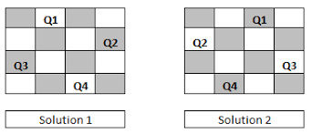
GOAL CONFIGURATION

Slide 5
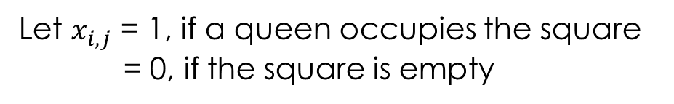
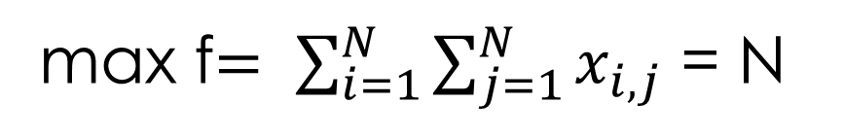
Objective function
Let $x_{i,j}$ = 1, if a queen occupies the square
= 0, if the square is empty
max f$= \sum_{i=1}^{N}{\sum_{j=1}^{N}{x_{i,j}}}$ = N

Slide 6
Heuristics
Is any approach to problem solving, learning, or discovery that employs a practical method not guaranteed to be optimal or perfect, but sufficient for the immediate goals
Where finding an optimal solution is impossible or impractical, heuristic methods can be used to speed up the process of finding a satisfactory solution
Heuristics in our problem???
Notes:
enabling a person to discover or learn something for themselves.
more quickly when classic methods are too slow

Slide 7
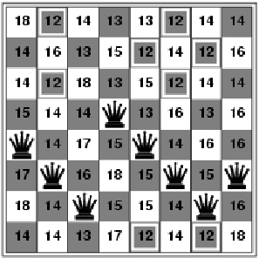

Slide 8
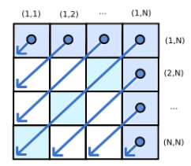
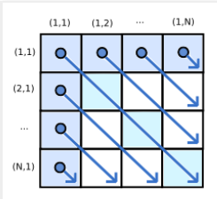
Backward Diagonals and Forward Diagonals

Slide 9
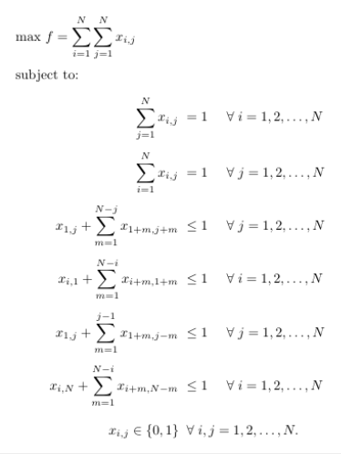
Conditions

Slide 10
Local Search Optimization Techniques
Hill Climbing Search
Local Beam Search
Genetic Algorithm
Simulated Annealing

Slide 11
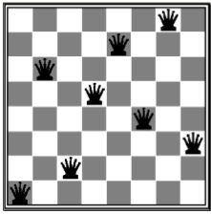
Hill Climbing Search
For H = 17
a.k.a. greedy local search
Move in the direction of increasing evaluation function
For H = 1
Notes:
Doesn’t back track
Terminates Local min.

Slide 12
Genetic Algorithm
Maintain a list of potential solutions
01
Modify potential solutions in parallel
02
Crossover
03
Randomly swap X number of Queen positions
Mutation
04
Randomly change a Queen’s position to a new random location
Solution in O(n³)

Slide 13
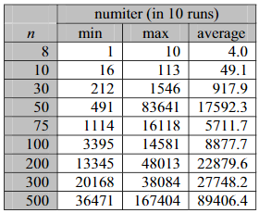
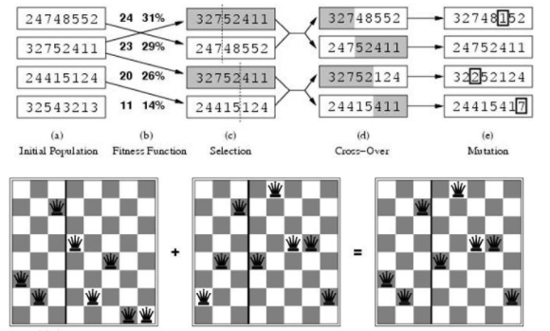

Slide 14
Simulated Annealing
Step 1
Start with a random initial placement. Initialize a high temperature
Step 2
Modify the placement through a defined change
Step 3
Calculate the difference in the energy due to the change made.
Step 4
Depending on the difference in energy, accept or reject the change.
Step 5
Update the temperature value by reducing the temperature very slowly.
Notes:
Escaping from local optimum
Higher temp higher the prob of replacing current soln with worst one

Slide 15
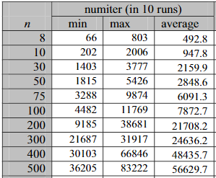
Analysis

Slide 16
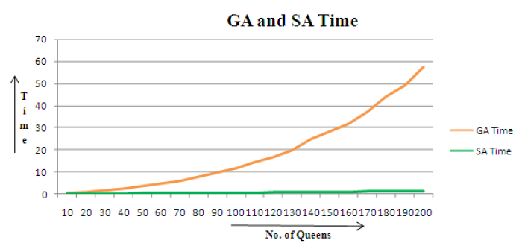
Comparison of Execution Time of SA vs GA

Slide 17
Backtracking
Place a queen in the top row, then note the column and diagonals it occupies
Then place a queen in the next row down, taking care not to place it in the same column or diagonal. Keep track of the occupied columns and diagonals and move on to the next row
If no position is open in the next row, we back track to the previous row and move the queen over to the next available spot in its row and the process starts over again

Slide 18
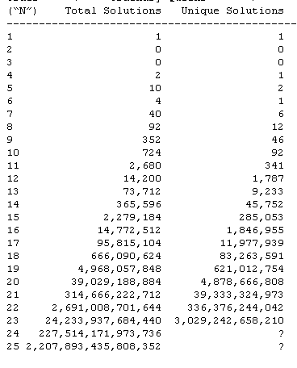
Time is an issue
Difficult for a search algorithm such as backtracking to find a solution for the N-queens problem in an acceptable amount of time.
It took over 9 months to get the results for N = 25

Slide 19
Thank You!!

